Slide 1
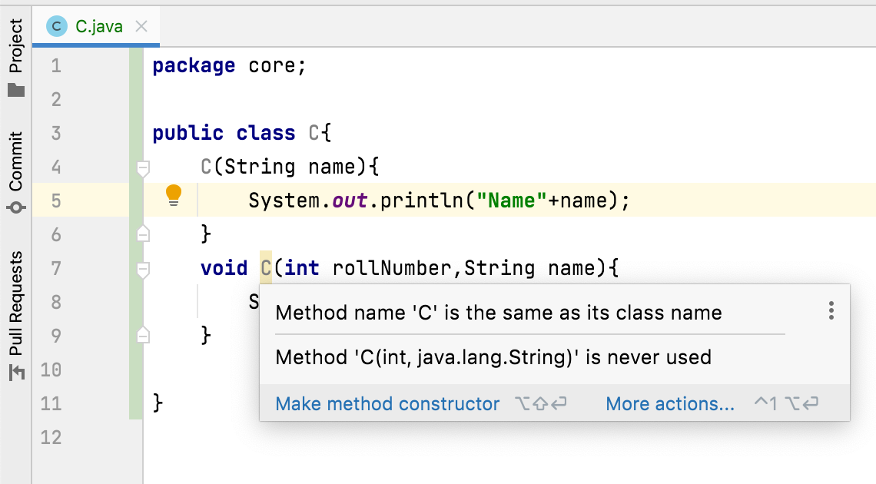

Do constructors have return type? OR
What happens if we keep return type for a constructor?
constructors in Java don’t have return type.
If we keep return type for a constructor, it will be treated as a normal method and also compiler gives a warning saying that method name is the same as its class name.

